Slide 1
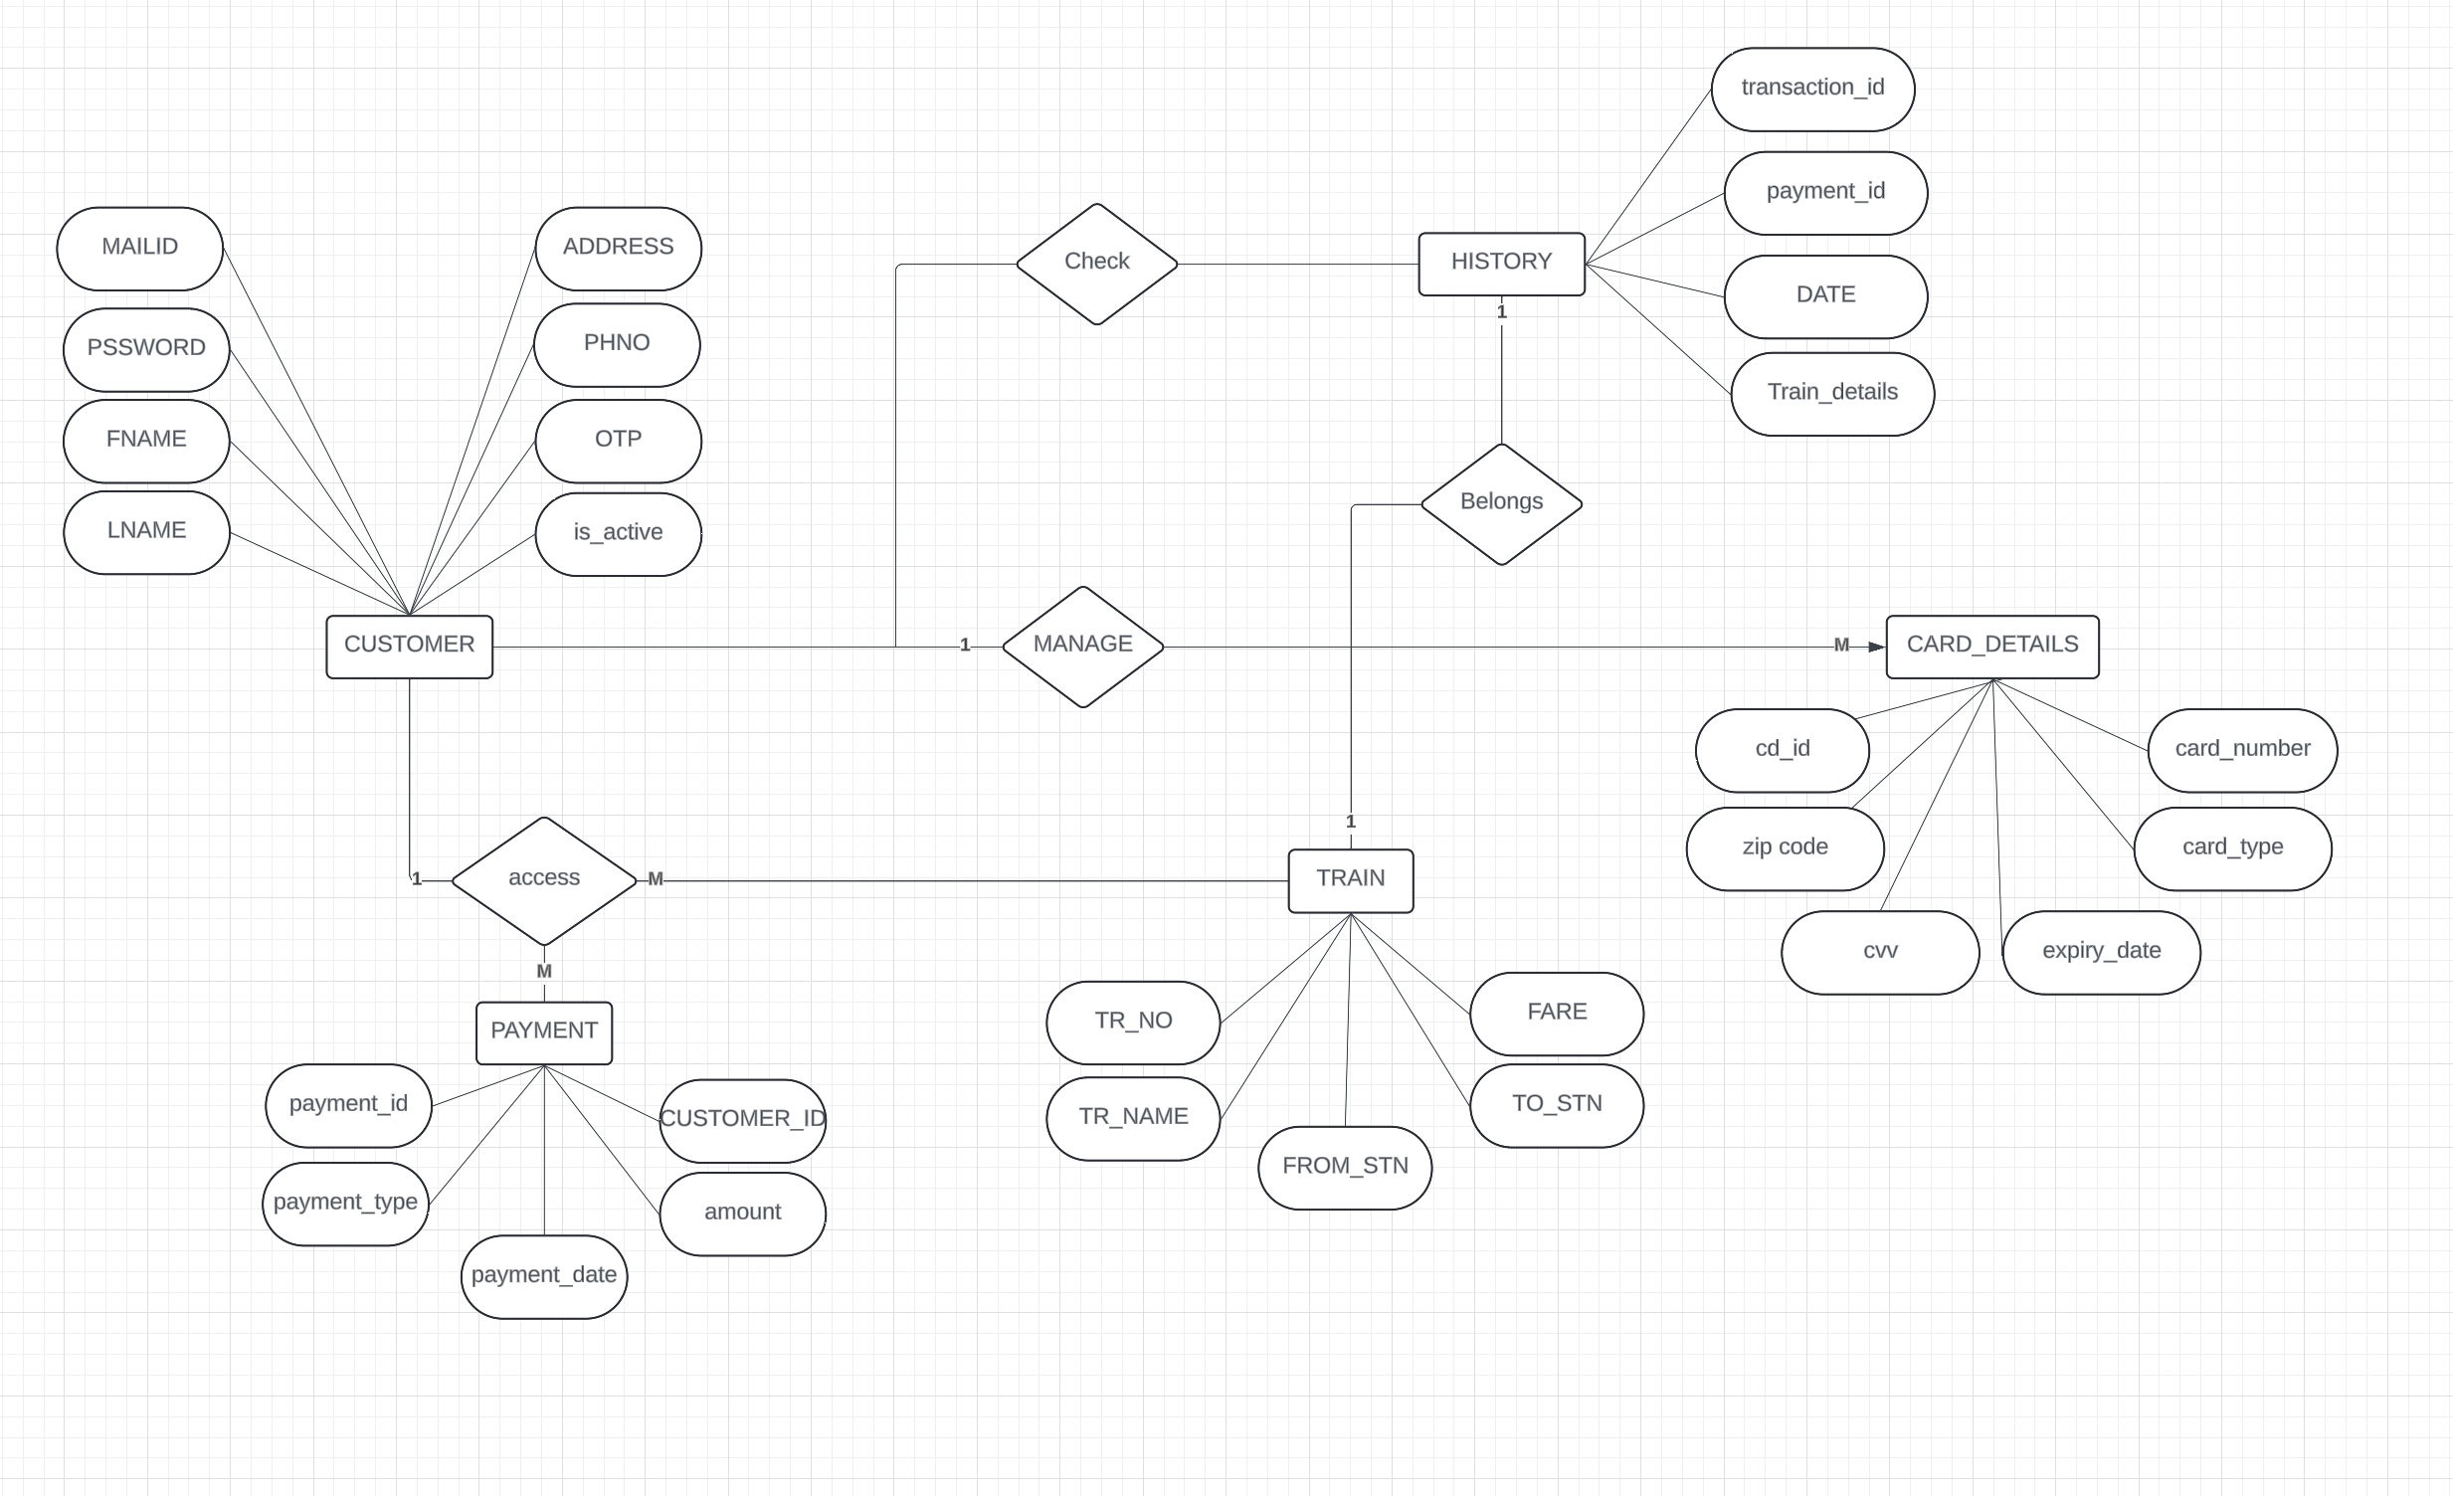
Conceptual ERD
Owner: Mehul
Peer-reviewer: Monil

Slide 2
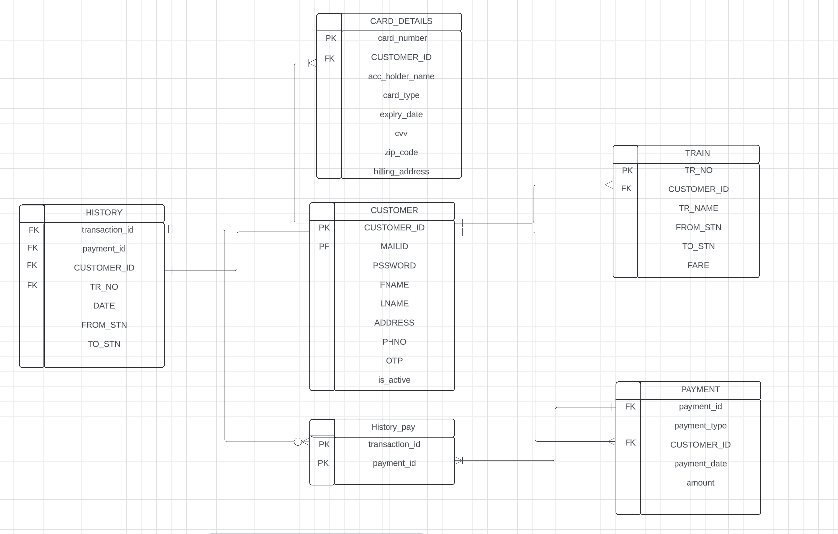
Logical ERD

Slide 3
List of Entities
Entity Name | Primary Attributes
Account Management (Customer details) | CUSTOMER_ID, MAILID, PSSWORD, FNAME, LNAME, STATE, CITY ZIPCODE, PHNO, OTP, is_active)
Finance Management (Card details) | card_number, card_type, expiry_date, cvv, zipcode
Product Management (Train schedule) | TR_NO, TR_NAME, FROM_STN, TO_STN, Avail_seats
Customer Requirements | transaction_id, payment_id, FROM_STN, TO_STN,

Slide 4
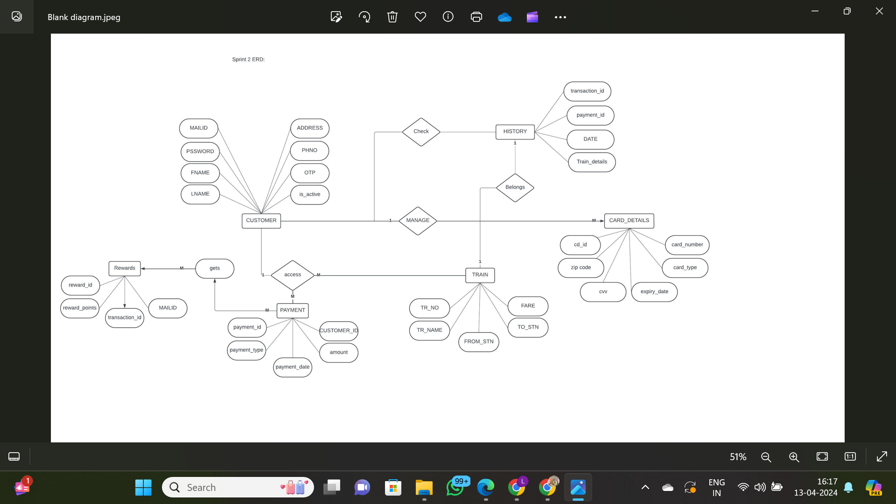

Slide 5


